Slide 1
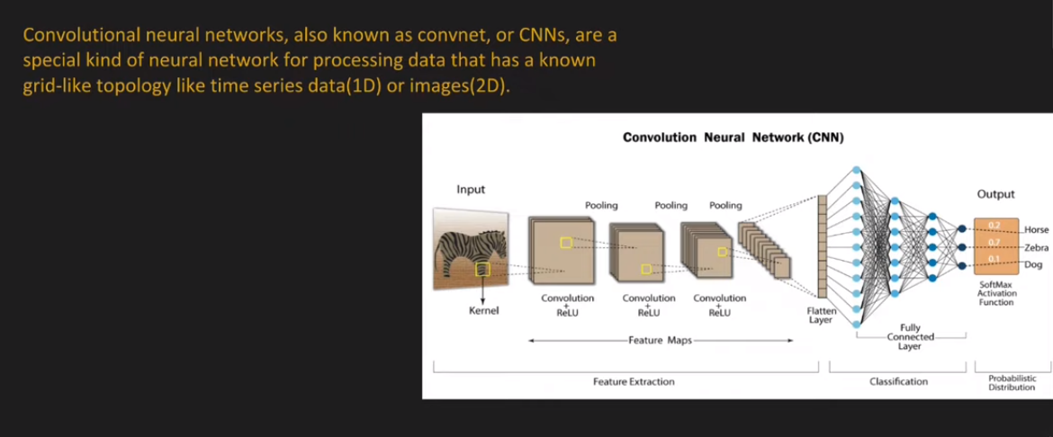
Convolutional Neural Network

Slide 2
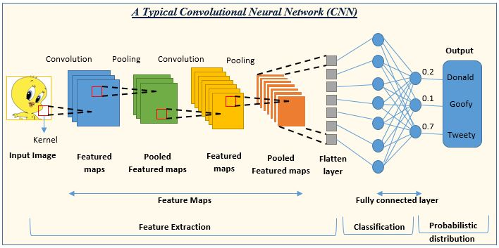

Slide 3
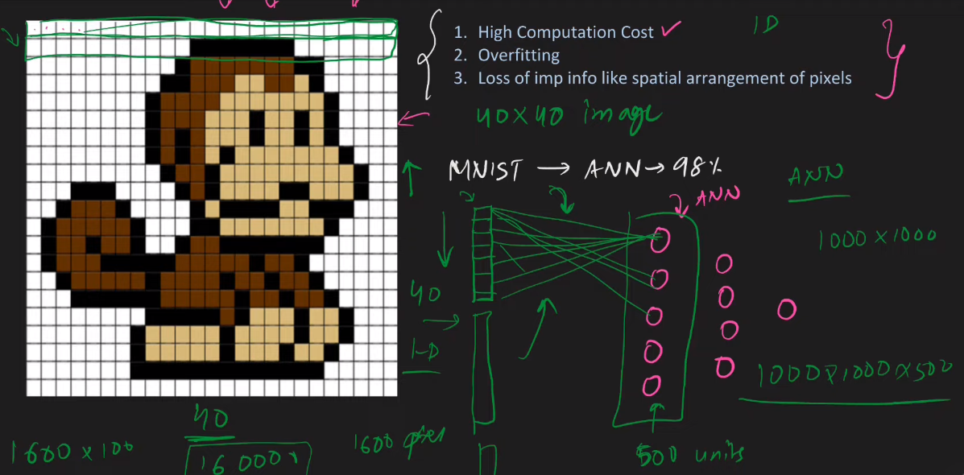
Why Not Use ANNs

Slide 4
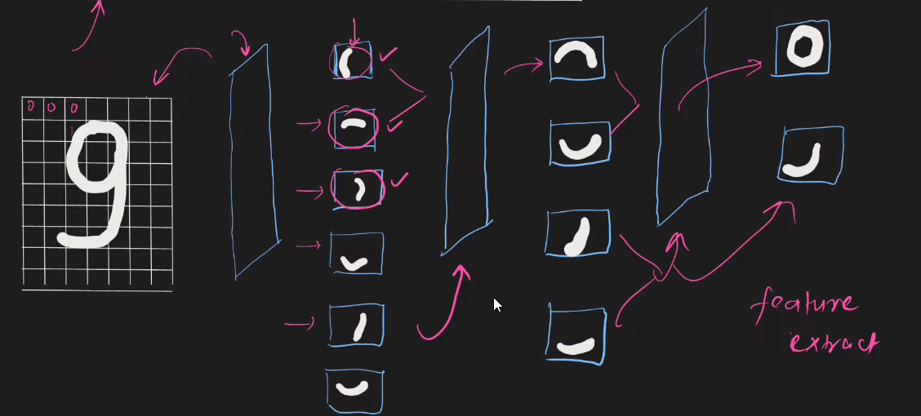
Intuition of CNN

Slide 5
Application of CNN

Slide 6
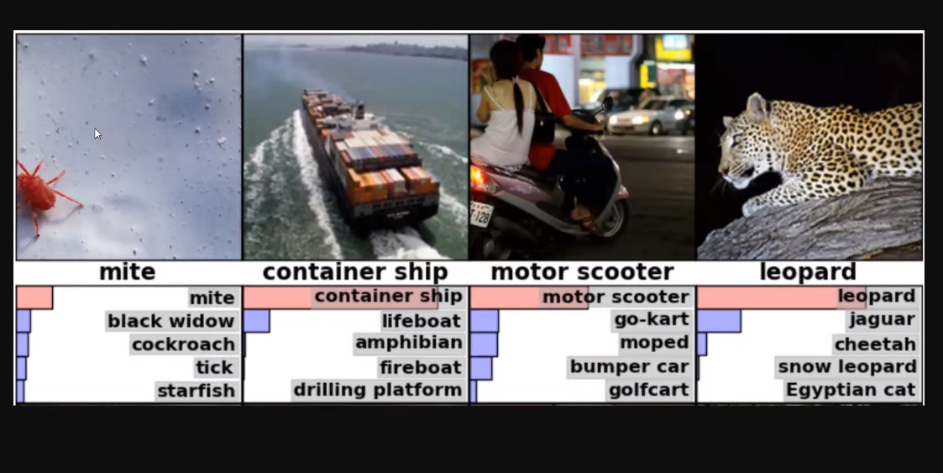
Image Classification

Slide 7
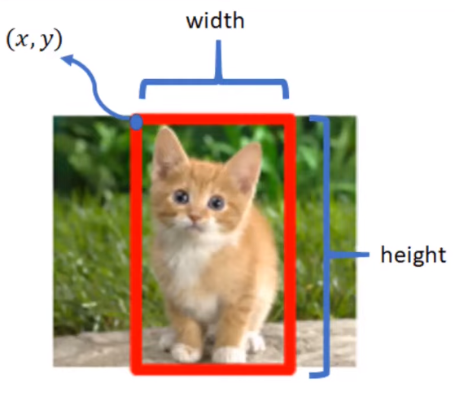
Image Localization

Slide 8
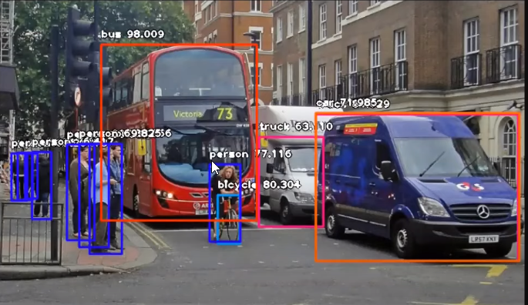
Object Detection

Slide 9
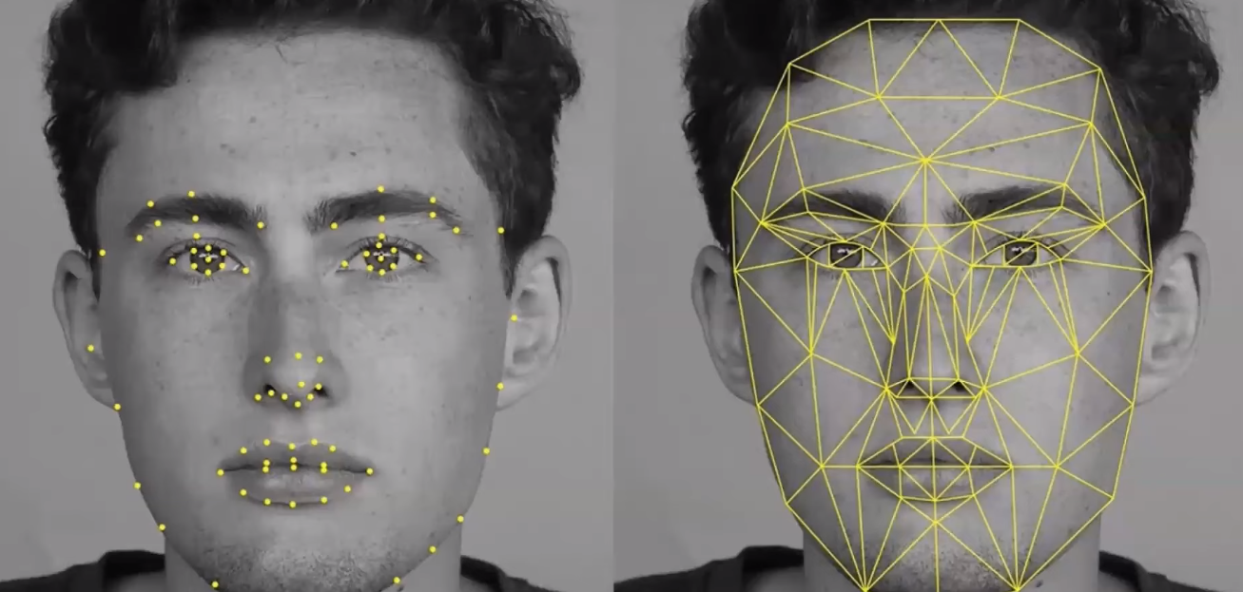
Facial Recognition

Slide 10
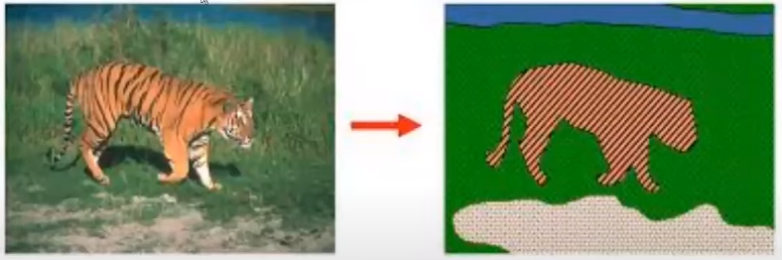
Image Segmentation

Slide 11
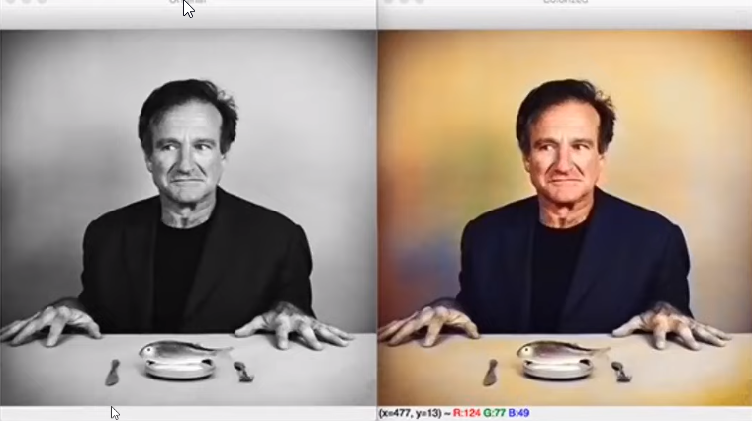

Slide 12
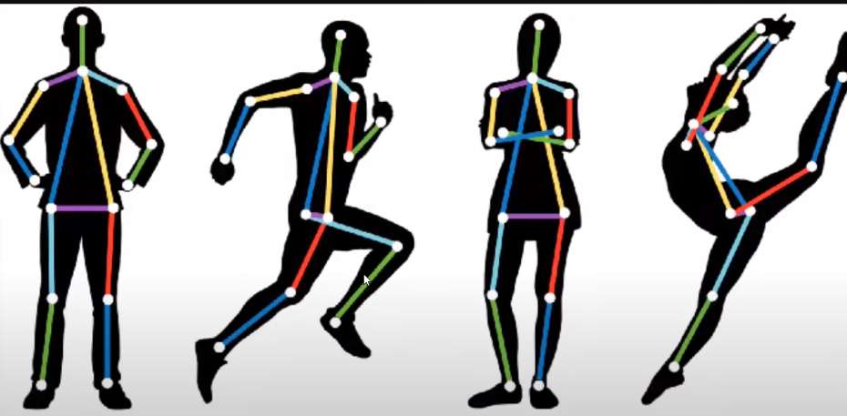
Pose Estimation

Slide 13
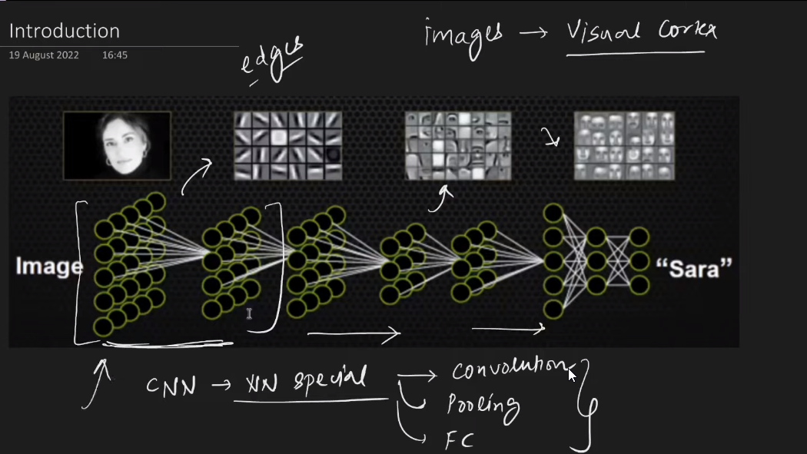

Slide 14
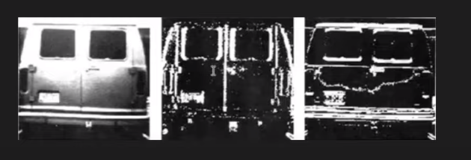
Convolution Operation (Edge Detection)
Vertical(Edge Detection)
Horizontal (Edge Detection)

Slide 15
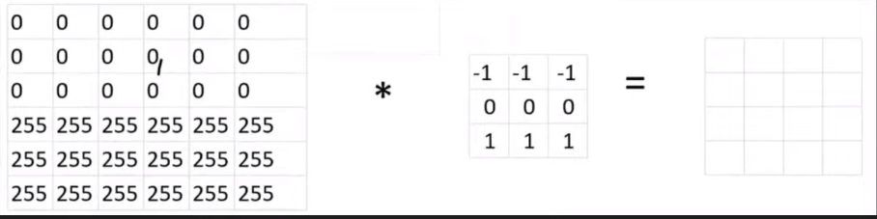
Convolution Operation (Edge Detection) Example

Slide 16
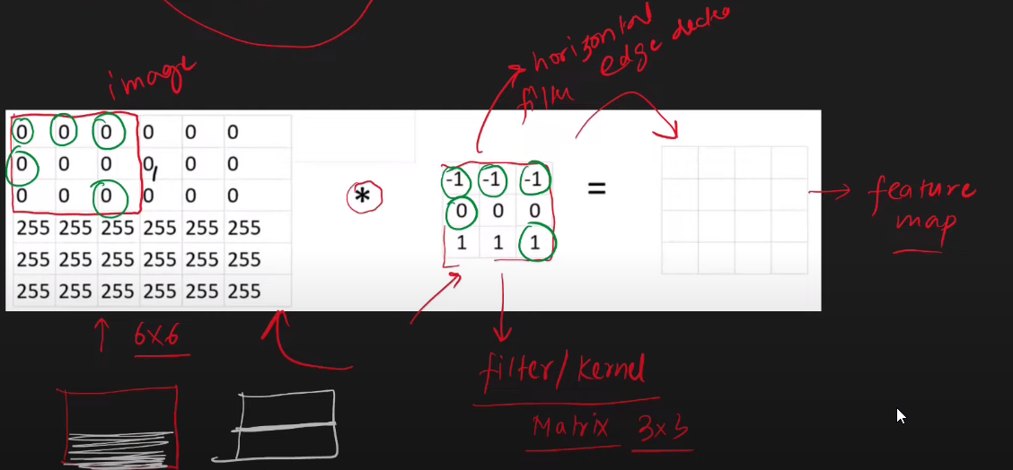

Slide 17
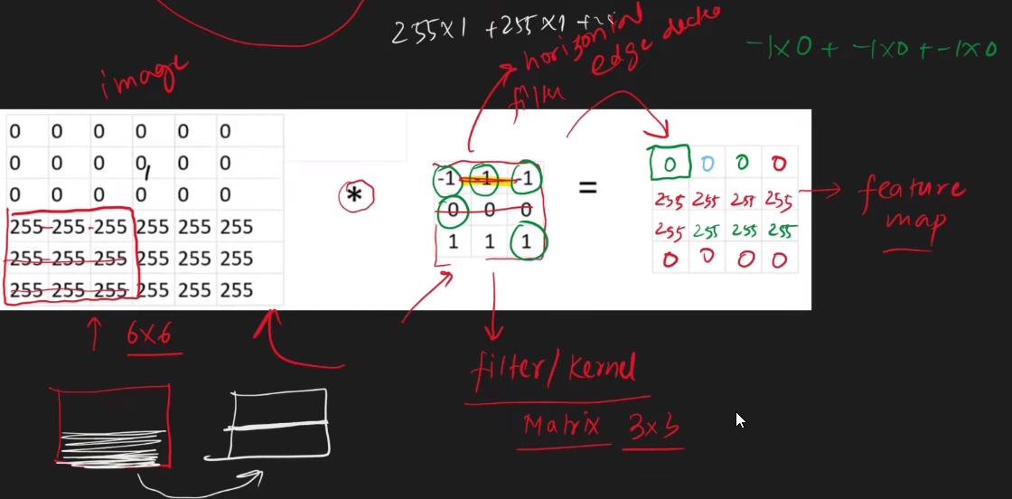

Slide 18
Convolution Operation (Edge Detection) Demo
https://deeplizard.com/resource/pavq7noze2

Slide 19
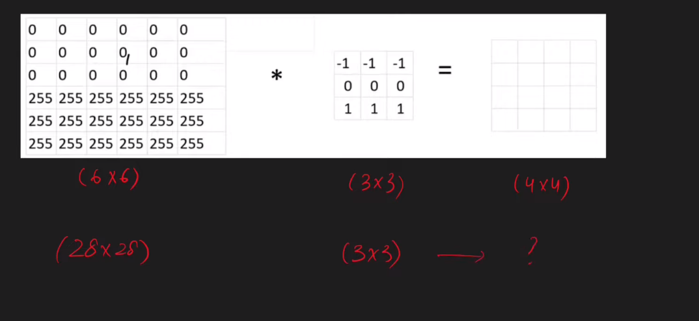

Slide 20
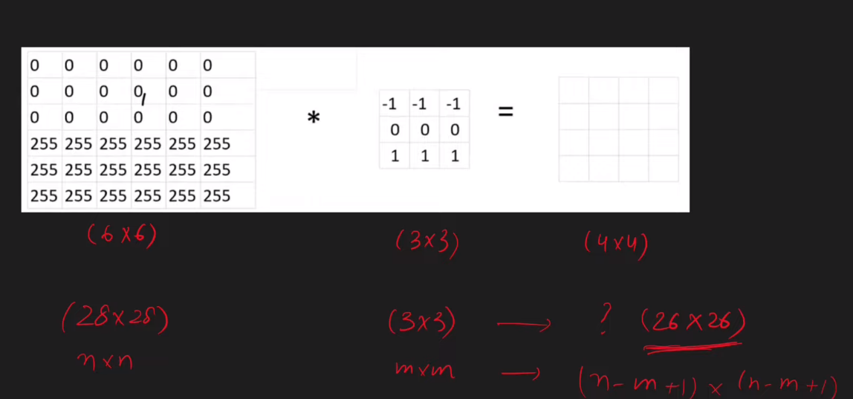

Slide 21
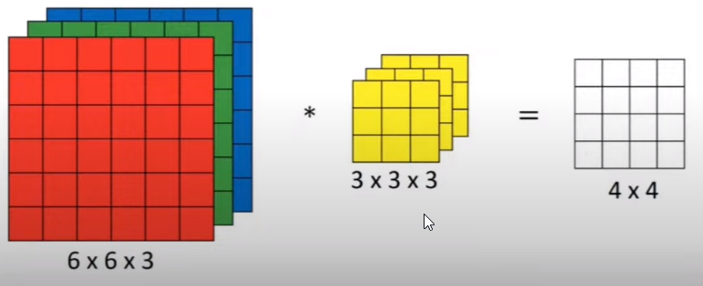
https://medium.com/swlh/convolutional-neural-networks-part-3-convolutions-over-volume-and-the-convnet-layer-91fb7c08e28b

Slide 22
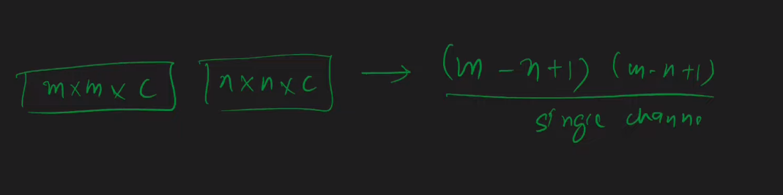

Slide 23
Padding & Stride
https://medium.com/latinxinai/convolutional-neural-network-from-scratch-6b1c856e1c07

Slide 24
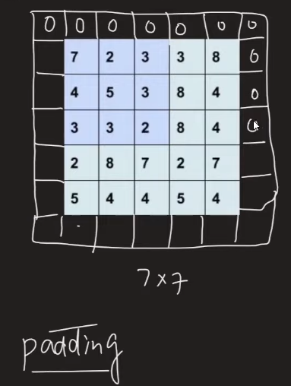
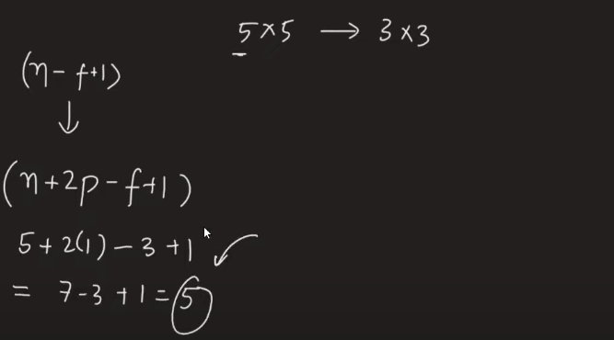

Slide 25
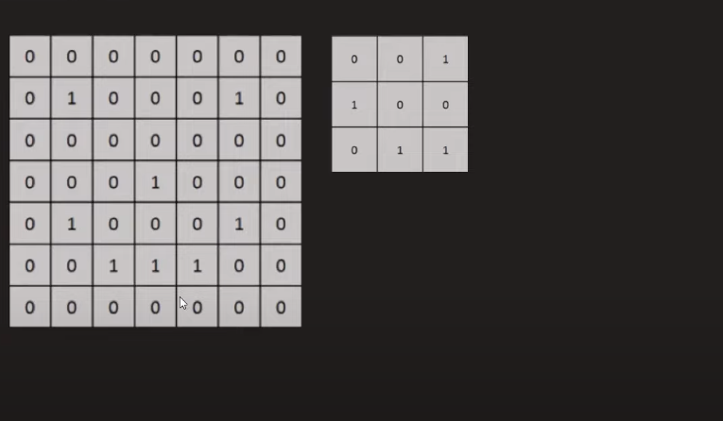

Slide 26
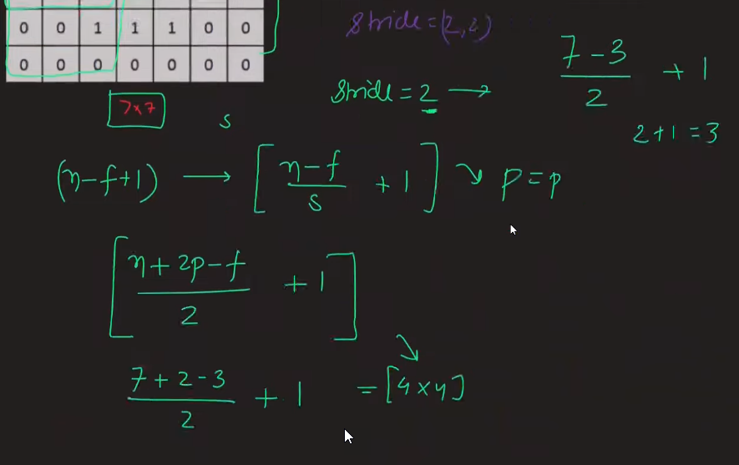

Slide 27
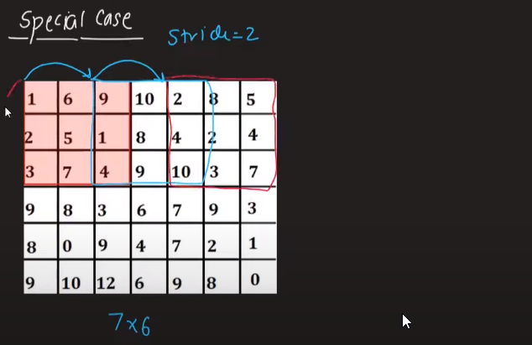

Slide 28
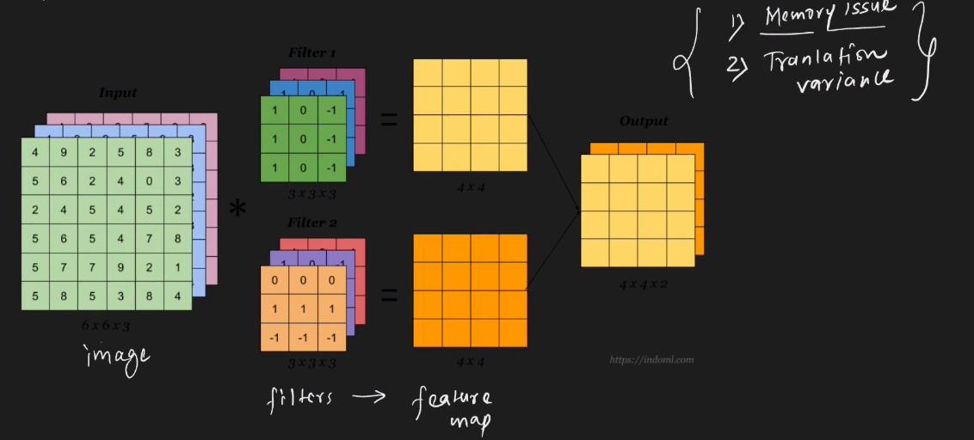
Max Pooling in CNN

Slide 29
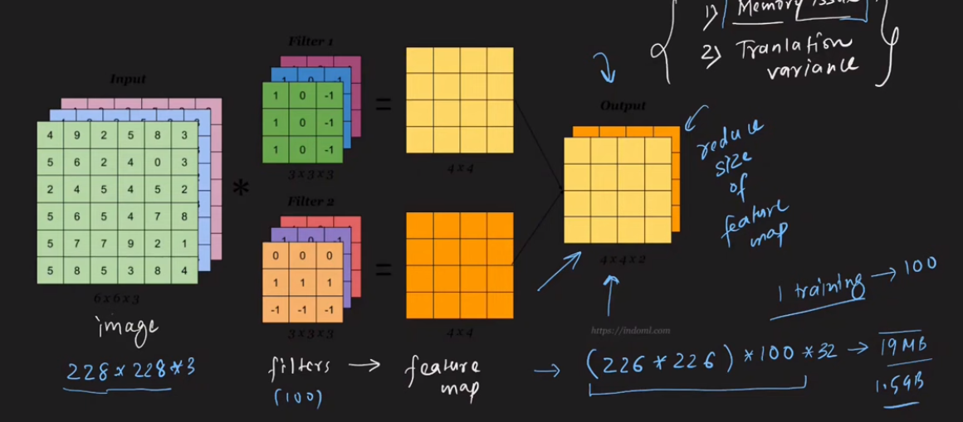
Problem with Convolution

Slide 30
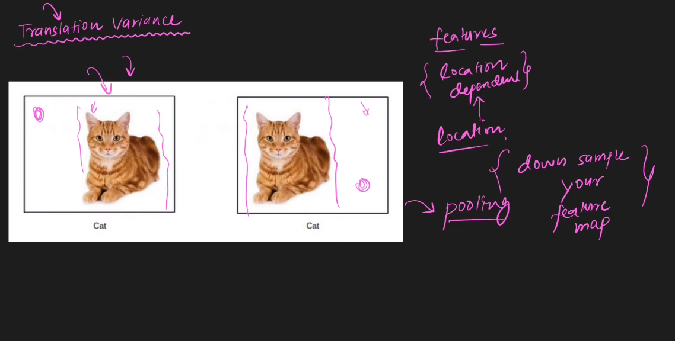

Slide 31
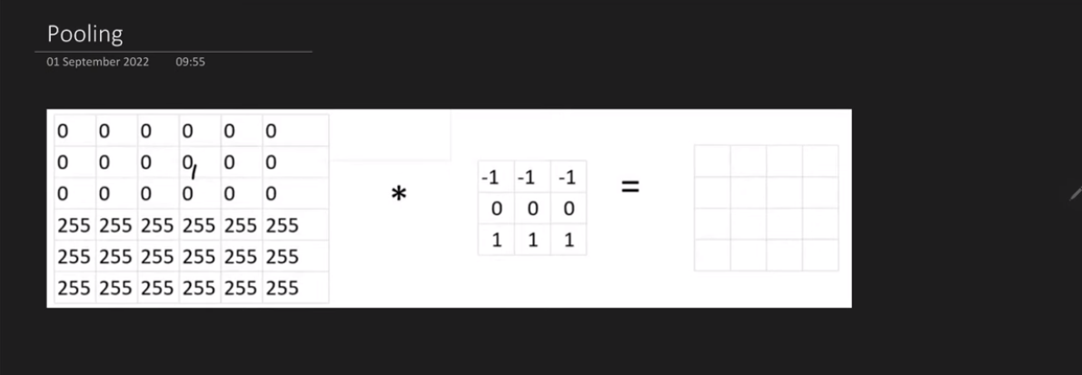
Pooling

Slide 32
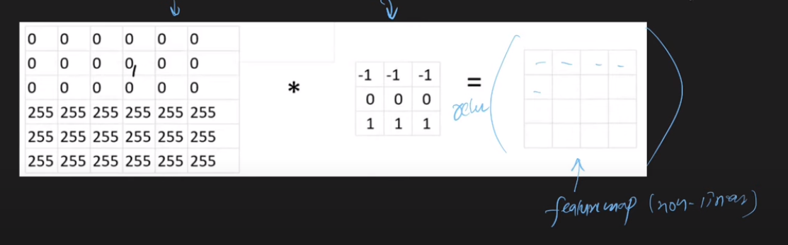
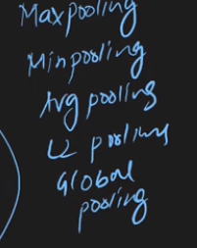

Slide 33
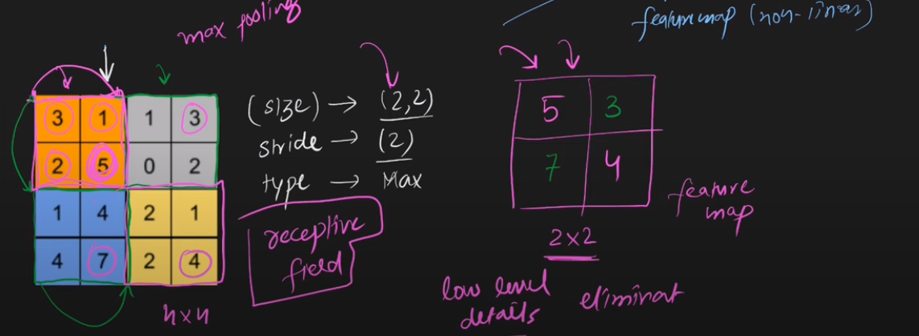
https://deeplizard.com/resource/pavq7noze3

Slide 34
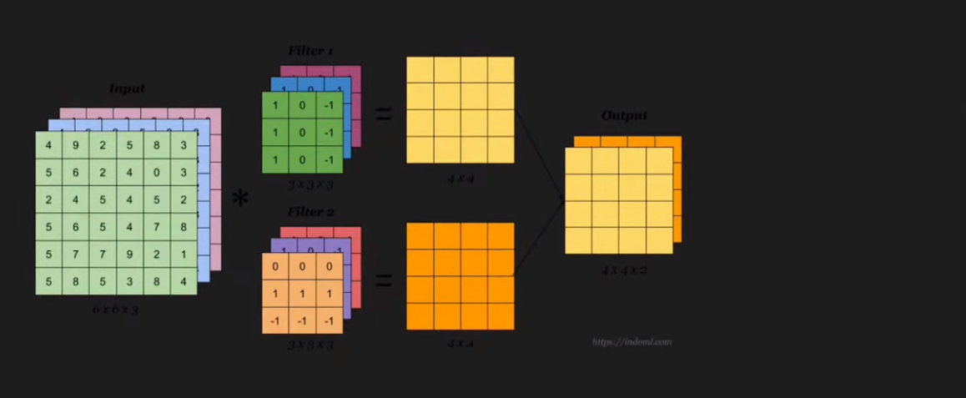
Problem on volumes

Slide 35
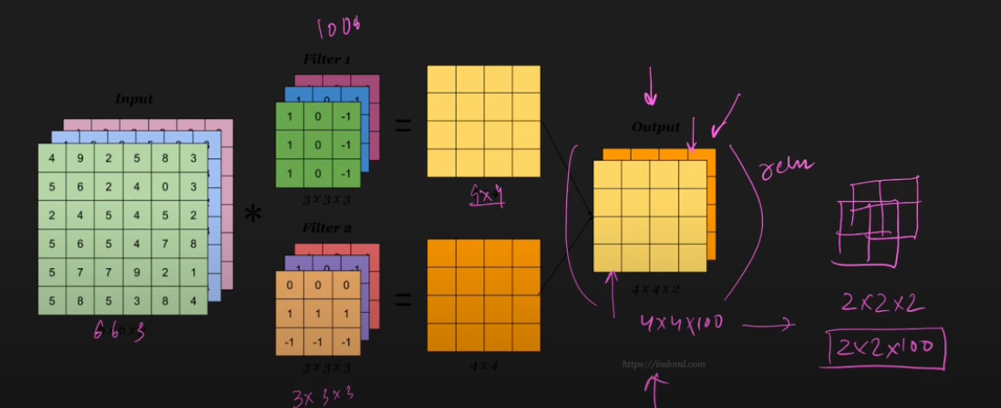

Slide 36
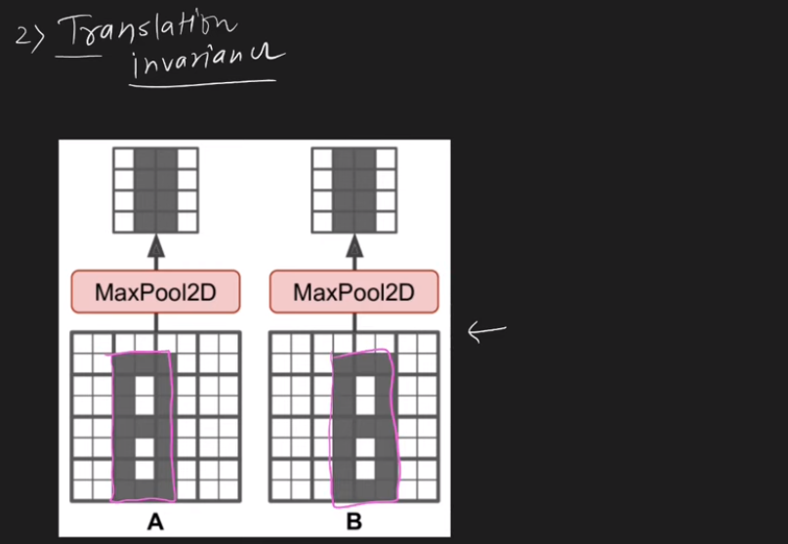
Advantages

Slide 37
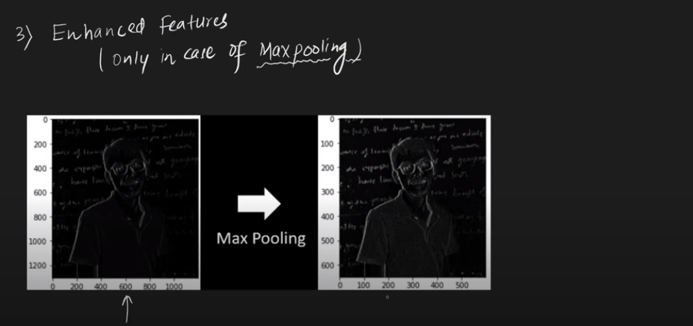

Slide 38
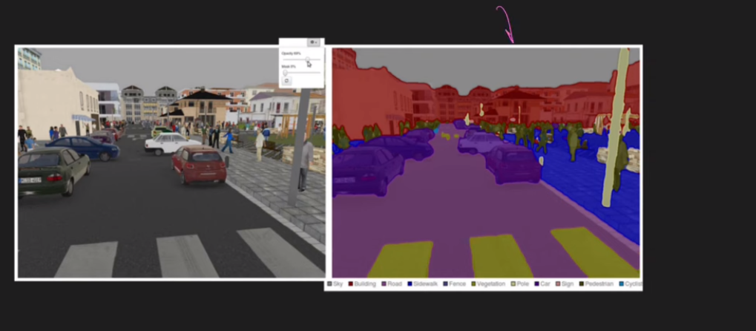
Disadvantages
Image Segmentation

Slide 39
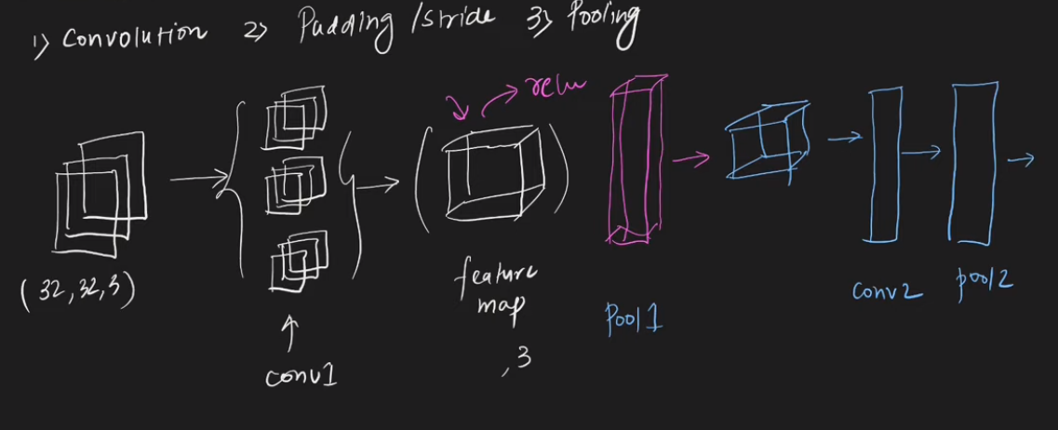
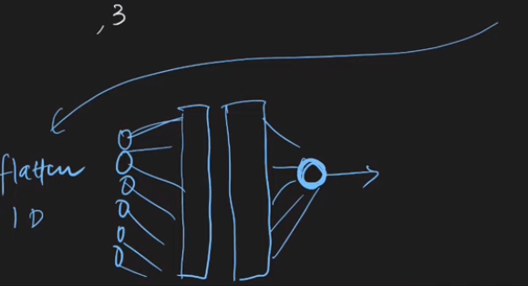

Slide 40
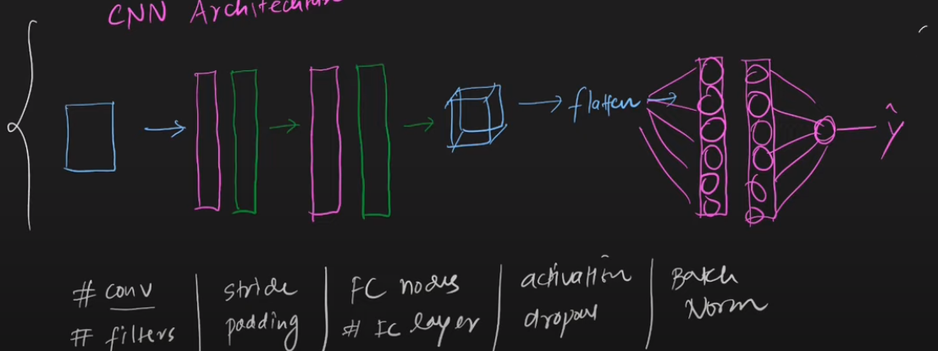

Slide 41
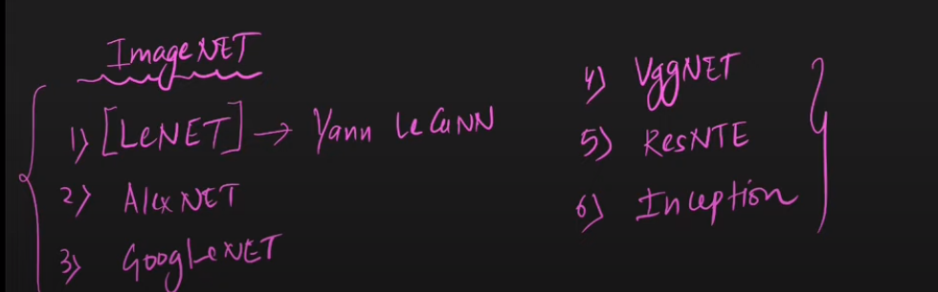

Slide 42
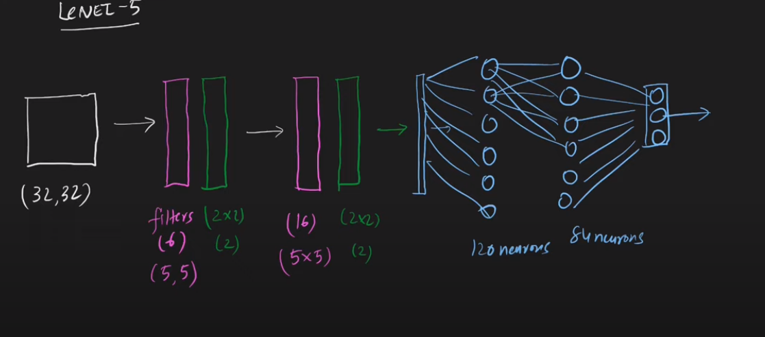

Slide 43
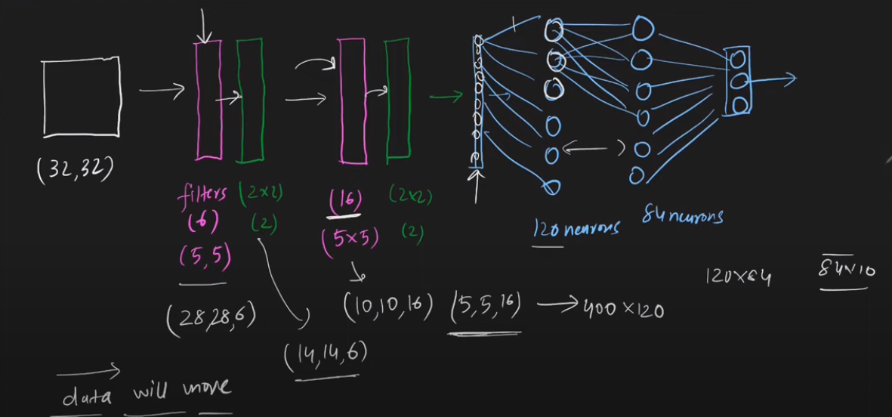

Slide 44
Pre-trained Models
1- Data Hungry
2- Time

Slide 45
A pre-trained model is a (DL) model that has been trained on a large dataset and can be fine-tuned for a specific task. Pre-trained models are often used as a starting point for developing DL models, as they provide a set of initial weights and biases that can be fine-tuned for a specific task.

Slide 46
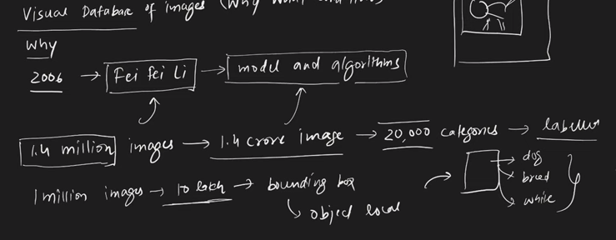


Slide 47
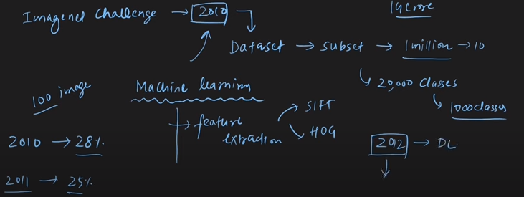
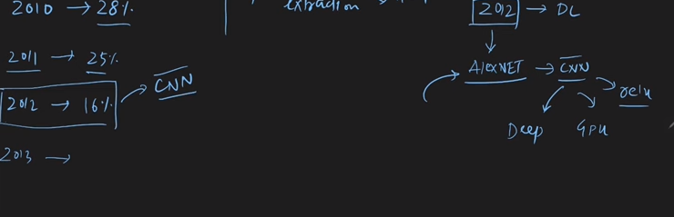

Slide 48
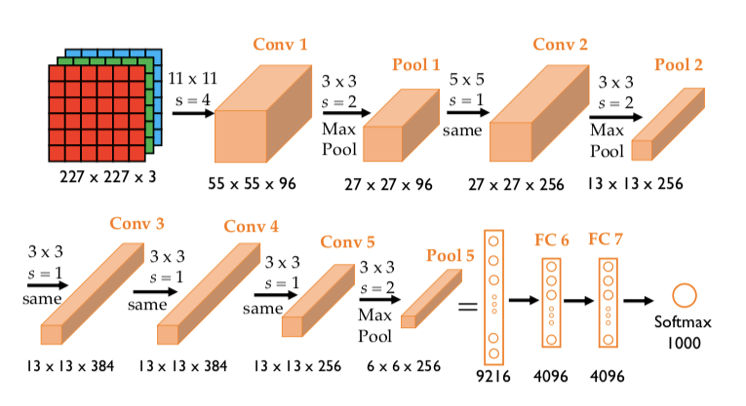
AlexNet

Slide 49
